Slide 1



Computer Graphics
9/11
A 2D SHOOTING GAME
Syed Zain Asif (172)
Muhammad Amas(077)

Slide 2


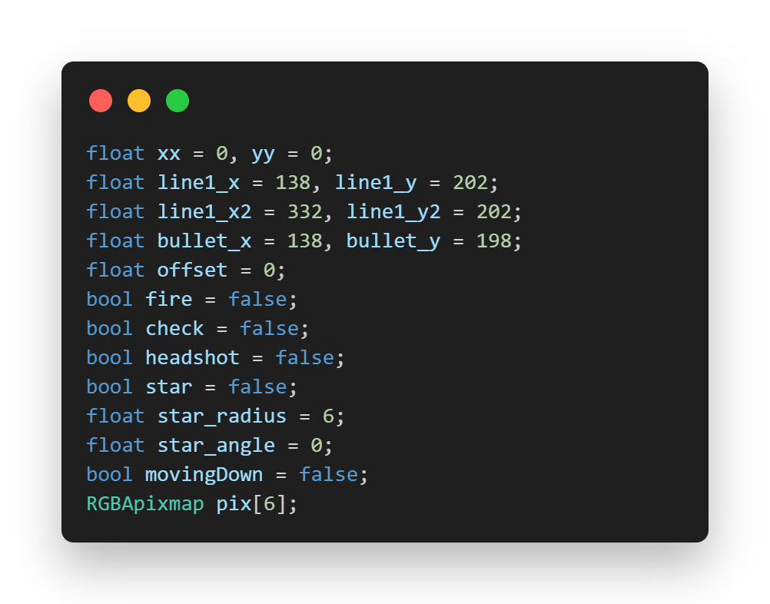

GLOBAL VARIABLE DECLARATIONS
This block defines global variables and constants used throughout the program

Slide 3
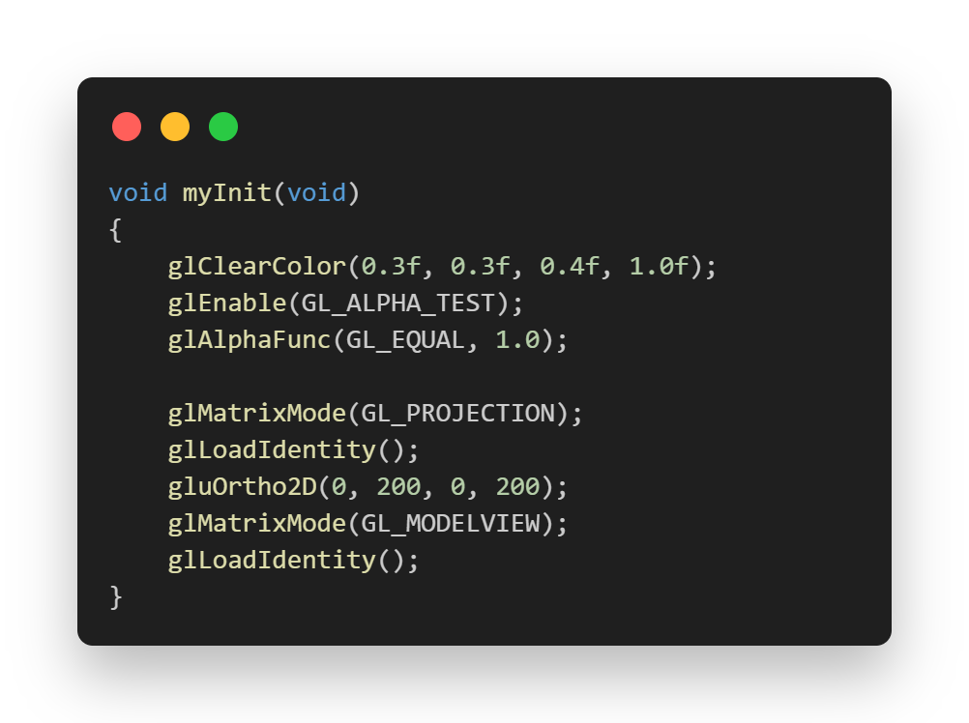

MYINIT FUNCTION
This block defines the myInit function, responsible for initializing OpenGL settings.
It sets the clear color, enables alpha testing, and configures the projection matrix for rendering.

Slide 4
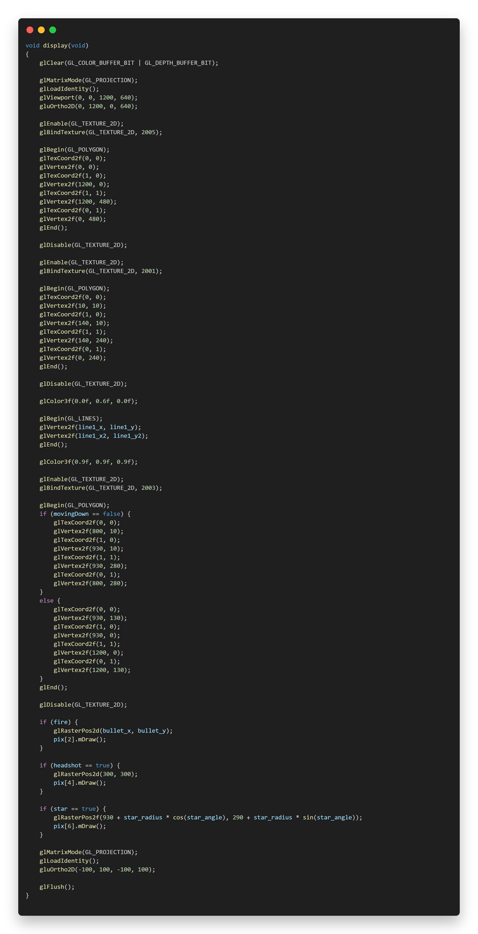
DISPLAY FUNCTION:
The display function handles rendering the game's graphics.
It begins by clearing the screen and setting up the viewport.
Textures are enabled and mapped onto polygons to create the game's visuals
.
Lines are drawn to represent certain elements.
Conditional rendering of objects like bullets and special items is also included.

Slide 5
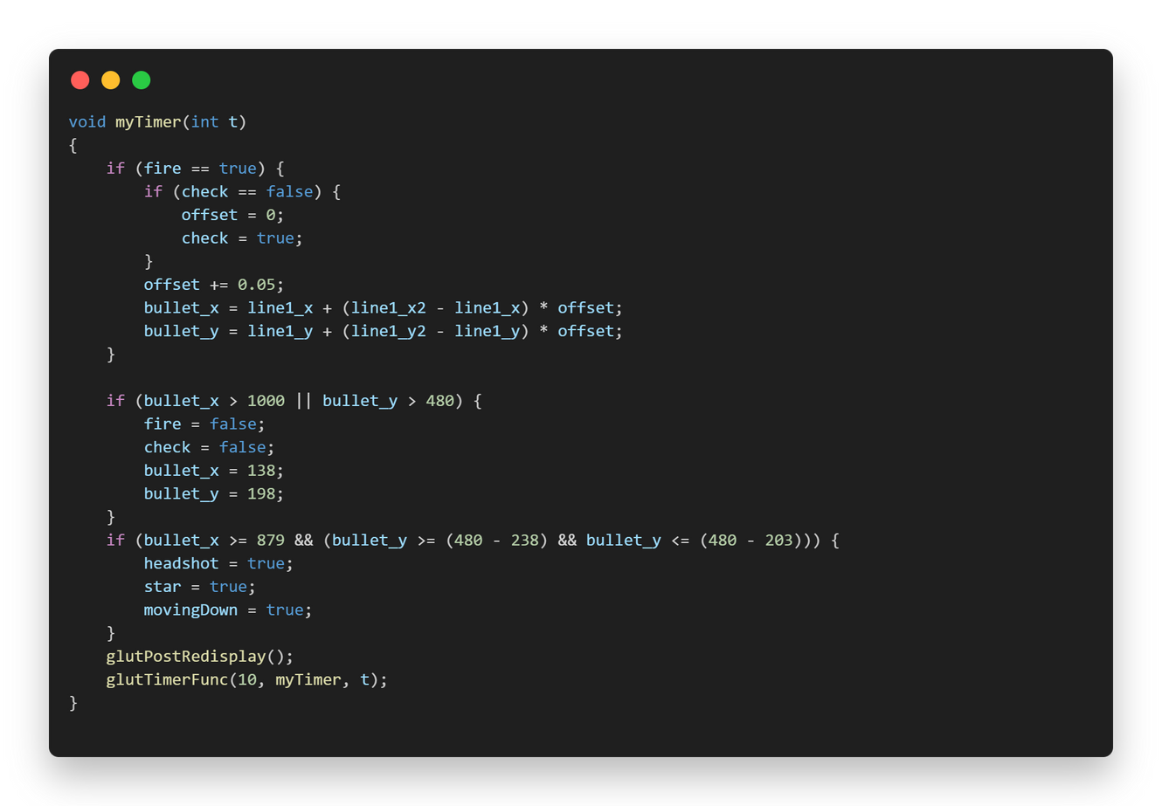
MYTIMER FUNCTION
The myTimer function is responsible for managing animations and updates.
It handles the movement of the bullet, including its trajectory and collision detection.
It also triggers the display function to refresh the screen.

Slide 6
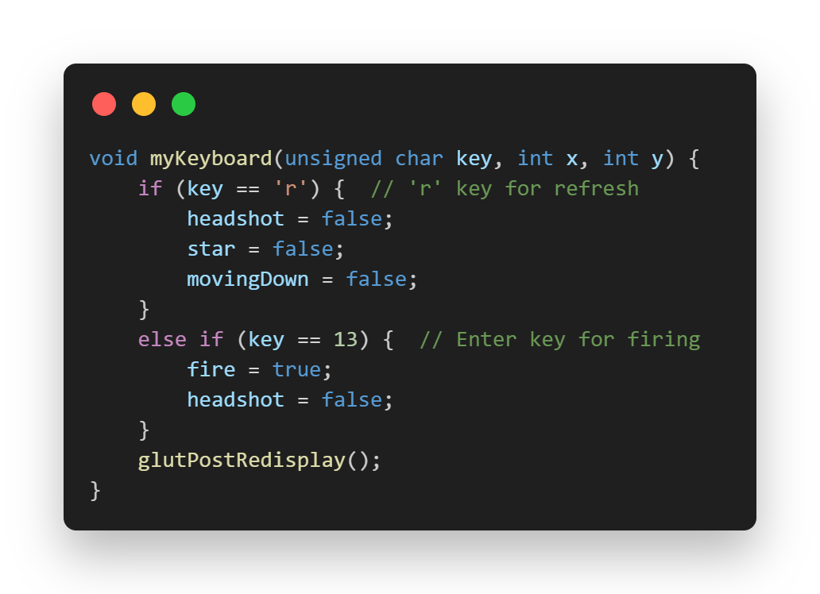
MYKEYBOARD FUNCTION
The myKeyboard function manages keyboard input.
It responds to key presses, including 'r' for refresh and the 'Enter' key for firing.
Depending on the key pressed, it updates game variables and triggers actions.

Slide 7
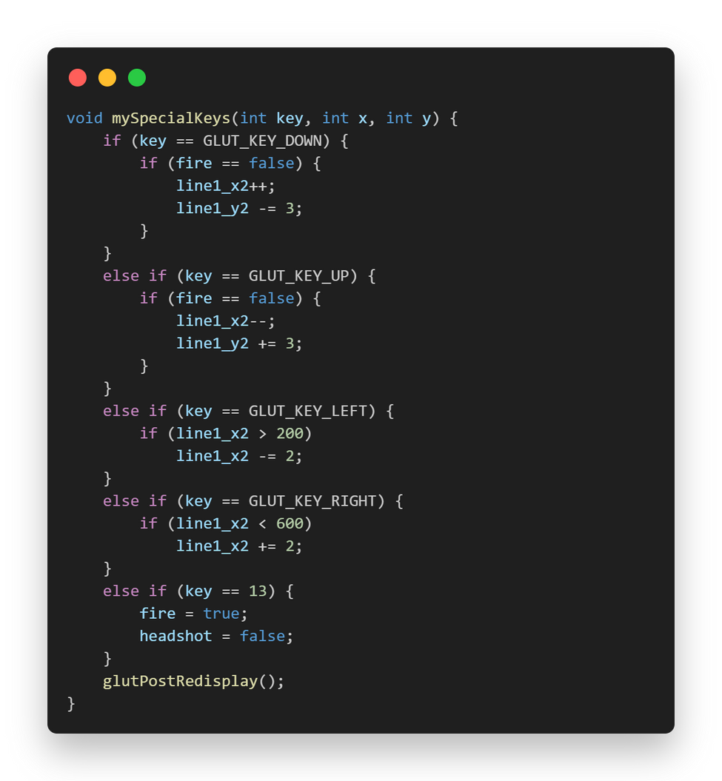
MYSPECIALKEYS FUNCTION
The mySpecialKeys function handles special keys, like the arrow keys.
It responds to arrow key presses for controlling certain aspects of the game, such as aiming and movement.

Slide 8
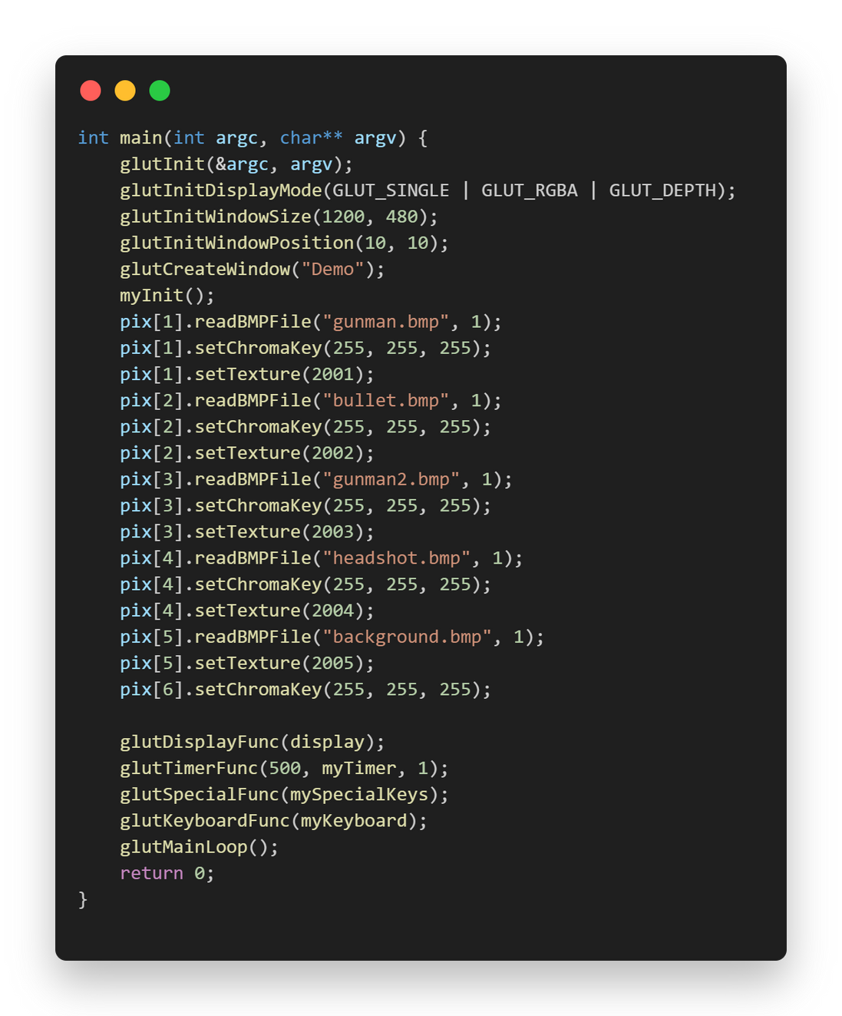
MAIN FUNCTION
The main function is the entry point of the program.
It initializes GLUT and sets up the window for rendering.
It loads textures and sets up function callbacks for display, timer, special keys, and keyboard input.
Finally, it enters the GLUT main loop, which continuously handles user input and rendering until the program is exited.

Slide 9
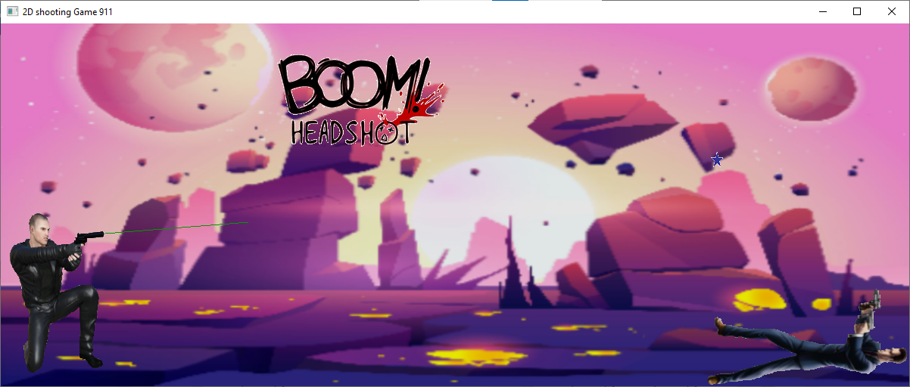
Output

